Slide 1
SANJIVANI COLLEGE OF ENGINEERING TOPIC : AN AUCTION SYSTEM
CIA 4 ACTIVITY – PROJECT
GROUP MEMBERS :
26_Aniket Borawake
34_Rushikesh Chobhe
37_Yashraj Darandale
Guided By : Dr.P.SaiPrasad Prof.V.N.Nirgude Prof.P.M.Dhanarao Prof.P.N.Kalavadekar

Slide 2
CONTENTS
Problem Statement
Software Requirement
System Architecture
Flow chart
Algorithm
Snapshots
MySql
Unix
Shell Script
Conclusion
Reference

Slide 3
PROBLEM STATEMENT
To implement an auction system using linked list data structure to store and manage bids using basic operations like Initialization,adding bid,removing bid,updating bid,retrieving bids, sorting bids.
Add a new bid
Remove a bid
Update a bid
Retrieve all bids
Retrieve all bids
Sort the bids
Get highest bid
Get the lowest bid

Slide 4
SOFTWARE REQUIREMENTS
System Requirements :
1)Hardware Requirements
Laptop / Computer
Processor : Intel core i3 or higher/AMD processors .
RAM : 4GB or higher .
Hard disk : 50 GB or higher
Input Devices –
a. Keyboard b. Mouse
Output Devices – Screen / Monitor
Software Requirements
a. Operating System : Linux Operating System
b. Coding Language : C++ , Shell Scripting
c. Database : MySQL

Slide 5
SOFTWARE REQUIREMENTS
User registration and authentication:
The system should allow users to create accounts with unique usernames and passwords and verify their email addresses. It should also provide login and logout functionality to authenticate users and prevent unauthorized access.
Auction creation and management:
The system should allow users to create new auctions with details such as item description, starting bid price, bidding deadline, and photos. It should also provide tools to manage auctions, such as the ability to edit, delete, and close auctions.
Bidding and payment processing:
The system should allow users to place bids on auctions, view current bids, and receive notifications when they are outbid. It should also manage payment processing for successful auctions, such as charging the winning bidder's payment method and releasing funds to the seller after deducting fees.

Slide 6
User feedback and ratings:
The system should allow users to provide feedback and ratings for other users, such as sellers and buyers. This can help build trust and improve the overall quality of the auction experience.
Accessibility:
The system should be designed with accessibility in mind, ensuring that all users can access and use the system regardless of their abilities. This could include features such as keyboard navigation, screen reader compatibility, and high-contrast mode.
Scalability and performance:
The system should be designed to handle a large volume of auctions and users without slowing down or crashing. It should also be scalable to accommodate growth and peak usage periods.
Security and privacy:
The system should provide robust security measures to protect user data and prevent unauthorized access. It should also comply with relevant privacy laws and regulations, such as GDPR and CCPA.

Slide 7
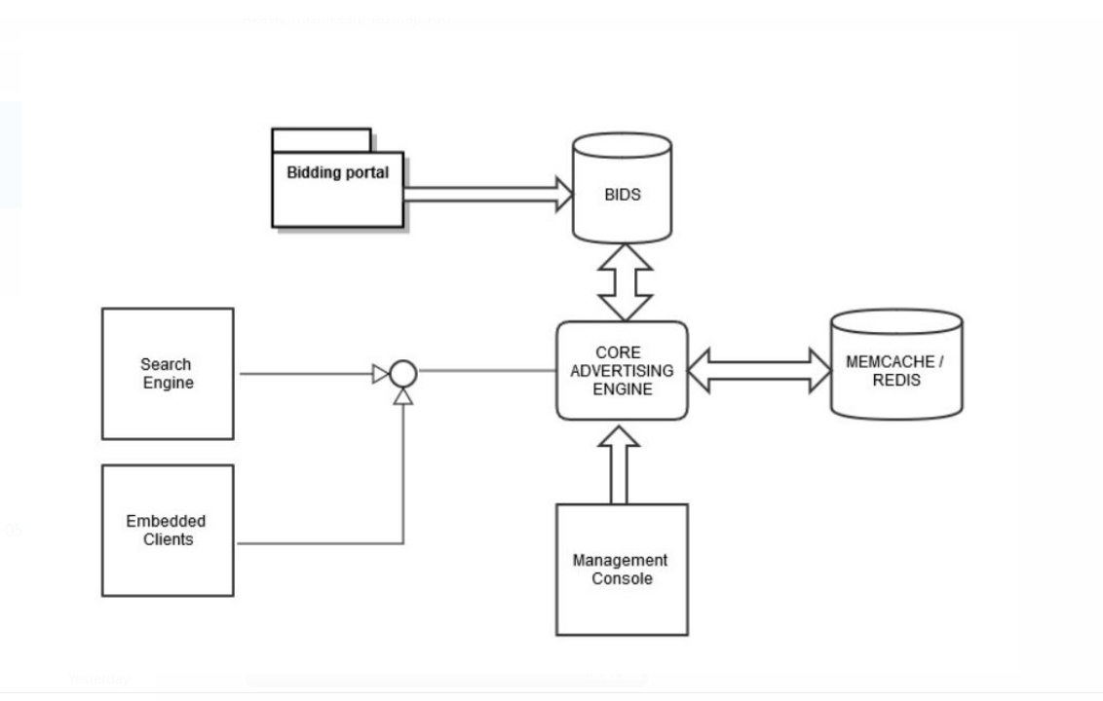
SYSTEM ARCHITECTURE

Slide 8
SYSTEM ARCHITECTURE
Data structures:
The system uses two struct types to store data:
- Auction
- Product
2. Main function:
The main function call other functions to interact with the auction system.
3. Create Auction function:
This function takes as input the name of a bidder and the amount of their bid, and returns a pointer to a new `Auction` struct with that information.
4. Add Auction function
(product name, bidder name, and bid amount), and then adds that auction to the system.

Slide 9
5. RemoveAuction function
To remove (product name, bidder name, and bid amount), and then removes that auction from the system.
6. UpdateAuction function
Provides ability to pass new bid value
7. SortAuctions function
Sorts the bids for each product in the system in ascending order by bid amount, using the bubble sort algorithm.
8. DisplayAuctions function
Shows information about bidder and bid

Slide 10
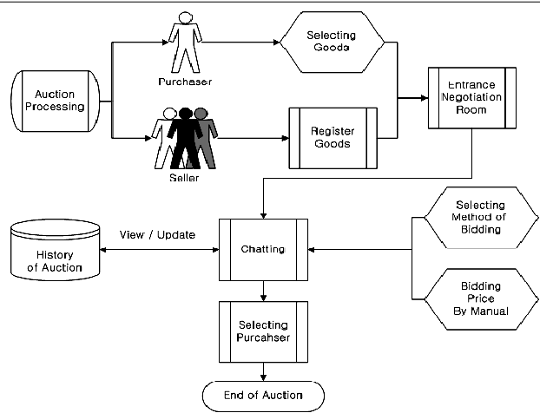
FLOWCHART

Slide 11
ALGORITHM
1
Start :
4
Retrieve bids:
Traverse the linked list.
display bid details stored in each node.
Initialize the linked list with a null head
Add a bid :
Create new node with bid info.
Update ptrs of prev and new nodes
update the head of the list
Sort bids:
Traverse the linkedlist.
compare bid details into concencative nodes.
If the bid details of current node are greater than the next nodethe swap the nodes.
2
5
3
Remove a bid :
locate the node contiainnig bid info.
update the ptrs of prev and next node
to bypass the node to be removed.
Stop
6

Slide 12
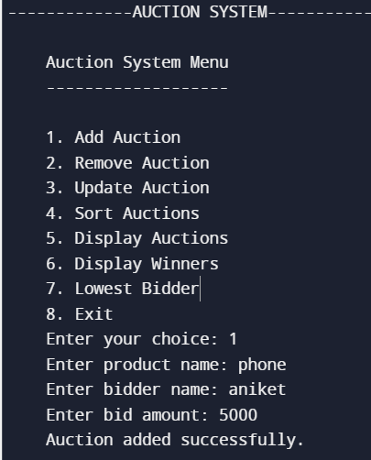
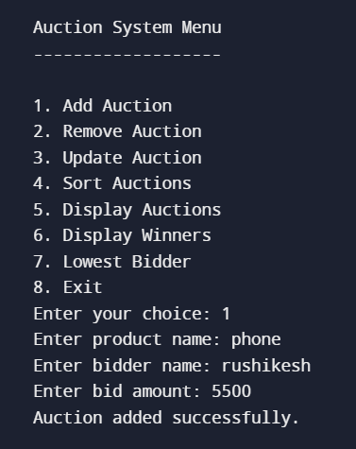
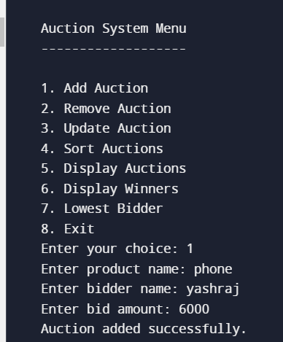
Snapshots

Slide 13
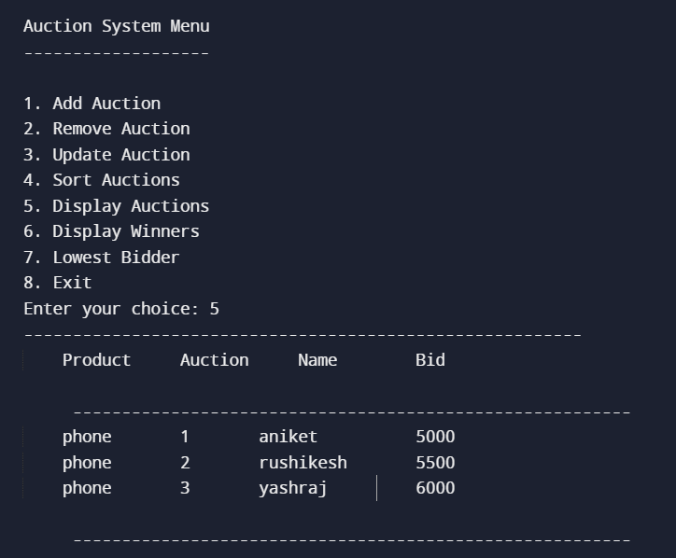
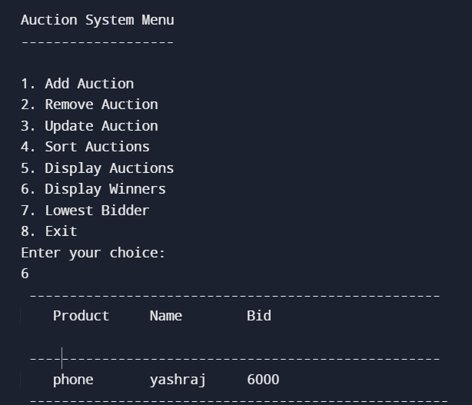
Display Auctions
Winner

Slide 14
MY SQL
Table 1
Table 2
-- Create table for auctions
CREATE TABLE auctions (
id INT PRIMARY KEY,
item_name VARCHAR(255),
starting_price DECIMAL(10, 2),
highest_bid DECIMAL(10, 2),
highest_bidder VARCHAR(255)
);
-- Create table for bids
CREATE TABLE bids (
id INT PRIMARY KEY,
auction_id INT,
bidder_name VARCHAR(255),
bid_amount DECIMAL(10, 2),
FOREIGN KEY (auction_id) REFERENCES auctions(id)
);

Slide 15
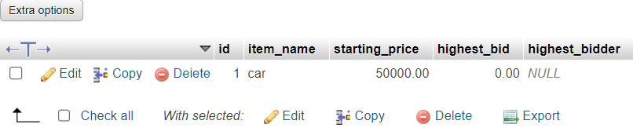
-- Insert a new auction
INSERT INTO auctions (id, item_name, starting_price, highest_bid, highest_bidder)
VALUES (1, ‘car', 50000.00, 0.00, NULL);

Slide 16
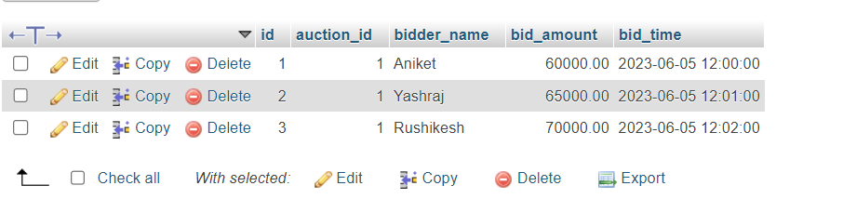
-- Insert a new bid
INSERT INTO bids (id, auction_id, bidder_name, bid_amount, bid_time)
VALUES (1, 1, ‘Aniket', 60000.00, '2023-06-05 12:00:00');
-- Insert a new bid
INSERT INTO bids (id, auction_id, bidder_name, bid_amount, bid_time)
VALUES (2, 1, ‘Yashraj’, 65000.00, '2023-06-05 12:00:00');
-- Insert a new bid
INSERT INTO bids (id, auction_id, bidder_name, bid_amount, bid_time)
VALUES (3, 1, Rushikesh’, 70000.00, '2023-06-05 12:00:00');

Slide 17
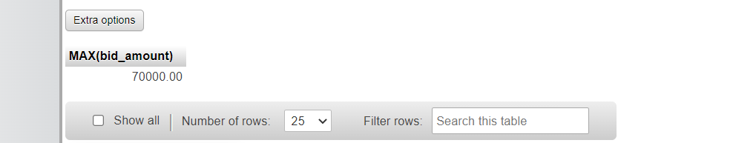
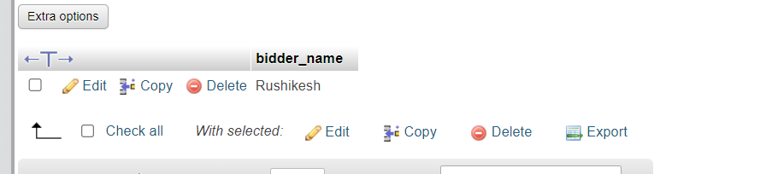
-- Get the highest bid for an auction
SELECT MAX(bid_amount) FROM bids WHERE auction_id = 1;
-- Get the bidder who made the highest bid for an auction
SELECT bidder_name FROM bids WHERE auction_id = 1 AND bid_amount = (
SELECT MAX(bid_amount) FROM bids WHERE auction_id = 1 );

Slide 18
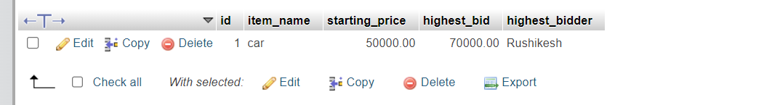
-- Update the highest bid and highest bidder for an auction
UPDATE auctions SET highest_bid = 70000, highest_bidder = ‘Rushikesh' WHERE id = 1;
-- Get all bids for an auction
SELECT * FROM bids WHERE auction_id = 1;

Slide 19
UNIX
Unix is a multi-user, multi-tasking and open source operating system. Unix acts as an interface between the application software and hardware. You can find Unix operating system mostly in servers, and also in many areas such as smartphones, cars, home appliances etc.
Some Basic commands in unix are:
echo | Displays a line of text
read | assigns the values of each field in the input line
ls | Lists files in the current directory
rm | Remove or delete file
mv | Move o rename files
mkdir | Make a directory
cd | Change current working directory

Slide 20
SHELL SCRIPT
A shell script is a computer program designed to be run by the Unix/Linux shell which could be one of the following:
The Bourne Shell
The C Shell
The Korn Shell
The GNU Bourne-Again Shell
EXAMPLE : Multiplication of 2 numbers
echo " Multiplication of two numbers in shell script”
read -p "Enter a number greater than zero: " var1
read -p "Enter another number greater than zero: " var2
read -p "Press any key to see the answer"
echo "The result is: "
let result=$var1*$var2
echo $result
OUTPUT : Multiplication of two numbers in shell script Enter a number greater than zero: 5 Enter another number greater than zero: 5 Press any key to see the answer: g The result is: 25

Slide 21
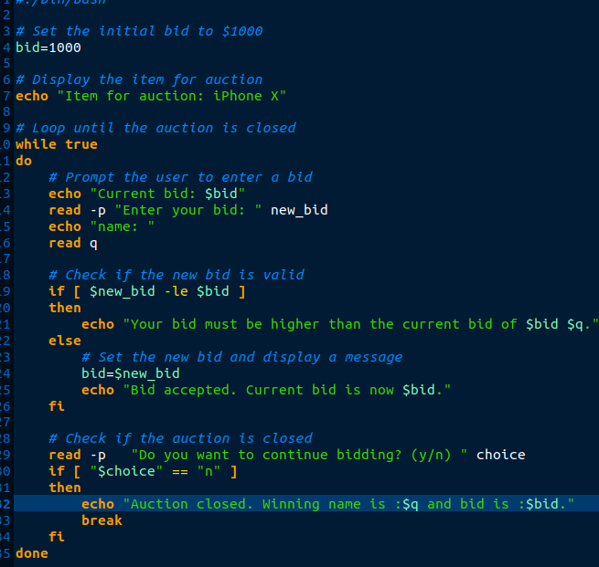
Shell Script

Slide 22
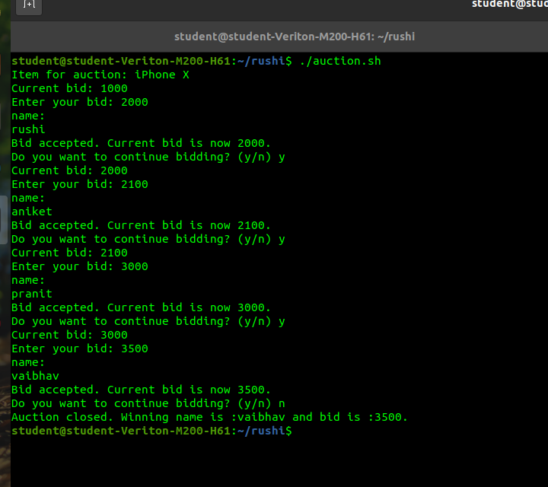
Output

Slide 23
Test cases :
Sr.no | Test Description | Expected Result | Actual Result | Remark
1. | Initialize the linked list with a null head | Link list should be initialize | Link list is initialized | pass
2. | Add a bid in Auction | Bid added successfully | Bid added successfully | pass
3. | Remove a bid form Bids | Bid remove successfully | Bid removed successfully | pass
4. | display bid details stored in each node | Bid Details is display | Bid Details is displayed | pass
5. | Sort bids in bids | Bid sorted | Bid sorted successfully | pass
6. | Display Auction | Auction should display | Auction Displayed | pass
7 | Display Winner | Display winner form Bids | Winner displayed | pass

Slide 24
Conclusion
In this project we study the concept of advance data structure ,Software Engineering , Operating System and Database management system . In Advance Data Structure we learnt the concept of link list and their types .
In Software Engineering we learnt the system architecture and software requirement and also learnt about auction system what is auction system and how its work .
The linked list data structure provides an easy way to add, remove, and iterate through bids, making it ideal for managing the bid history in an auction system.
Overall, a linked list implementation for an auction system provides a scalable and determining the winner of an auction.

Slide 25
References
1. https://www.w3schools.com/sql/
2. https://www.javatpoint.com/software-engineering
https://www.programiz.com/cpp-programming
https://www.geeksforgeeks.org/data-structures/linked-list/
https://www.tutorialspoint.com/unix/shell_scripting.htm

